Slide 1


Demand Forecasting for Brazilian Logistic Company using Machine Learning Models
and its Comparative Analysis
Team 3
www.factspan.com
Notes:
Done

Slide 2


Team & Mentors Details
Team Members
Hussnain Ashraf
Aaron Gunasingh
Kundan Kumar
Sakshi Gupta
Shailendra Kumar Ravi
Mentors - Technical & Capstone
Shashank Pullela
Priya Tony
Vishnu D
Sandeep Vijay

Slide 3

Presentation Flow
Problem Statement
Solution Approach
Project Timelines
Dataset Overview
EDA : Findings and insights
ML Model
Dashboard Preparation
Challenges and lessons learnt
Conclusion

Slide 4

Problem Statement
“For Brazilian Logistic Company, build a Model that forecasts the demand for daily treatment.”
Use different ML algorithms and compare models results.
Business Problem / Goals:
To Analyze historical data and identify trends in Order patterns.
To Identify the potential Sectors or Order Type where demand is high or low.
Use forecasting to explore expansion opportunities for the logistic company.
Build ML Models for forecasting the demand for the logistic company and then compare all the Models to find the best fitted Models.

Slide 5
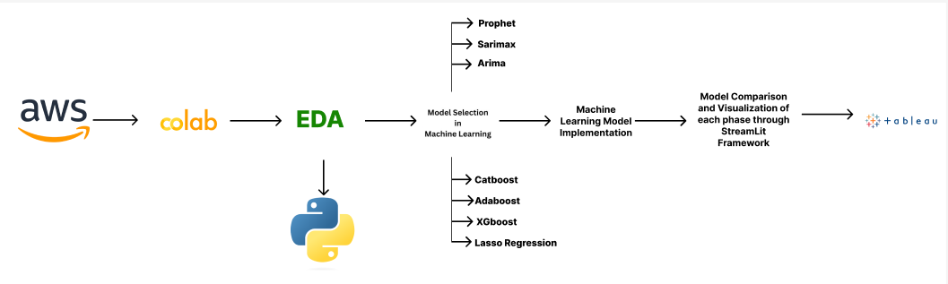
Solution Approach
Workflow Diagram
Fig1. Box Plot

Slide 6
Solution Approach
Machine Learning Flow Diagram
Fig.2 Architecture Diagram

Slide 7

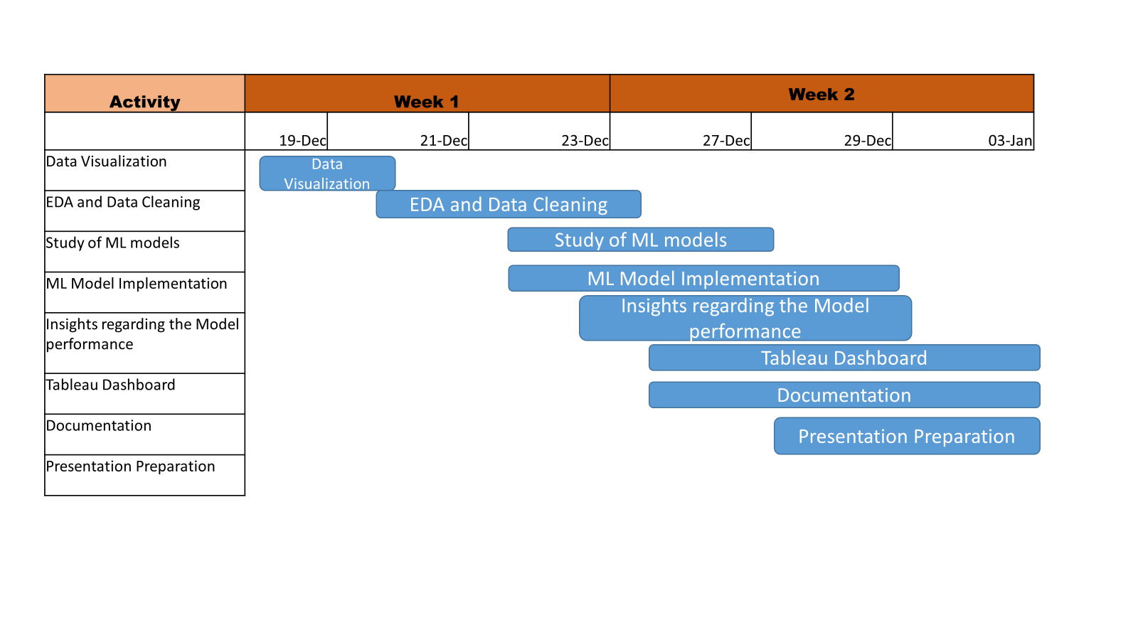
Project Timelines:

Slide 8

Dataset Overview:
Brazilian Logistic Dataset has 3 Months of Data, Consisting (60*13)
In the dataset there are 2 columns given which are Urgent and Non-Urgent Orders which sum up to the Target (total Orders).
There are other 3 Columns Order_type_A, Order_type_B & Order_type_C which sum up to the total orders as well as sum of Urgent and Non-Urgent Orders.
There are various sectoral orders are also given like Banking sector, Traffic sector and Fiscal sector.
Since it is a timeseries dataset so we are having the columns: “Week of the Month” and “Day of the Week”.

Slide 9
EDA ( Exploratory Data Analysis):
After understanding the data, for statistical analysis and data visualization we have done the EDA.
In EDA we have done Statistical Test, Univariate/Multivariate Analysis, Data Cleaning, Data Normalization and visualization with different plots(like Scatter plot, Box plot, Line charts etc.)
During the EDA we have got no Nulls Value , no Duplicate values .
We have validated our data by using condition over the week of the months and Day of the week .
we have added 2 more columns that’s the day and the month from the date columns.

Slide 10
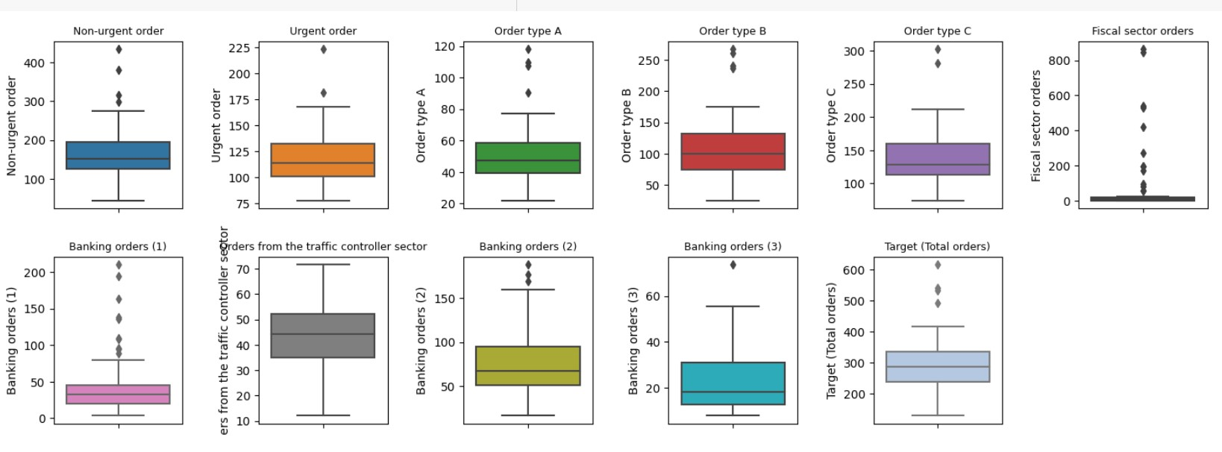
EDA ( Exploratory Data Analysis):
By Using the Box Plotting we have observed that there are some outliers in the different sectoral orders but most important visualization we observed that Fiscal Sector Orders have most of the outlier .
Fig.1Box Plot

Slide 11
EDA ( Exploratory Data Analysis):
Scatter Plot
Scatter plots are used to visualize the relationship between two continuous variables.
So , We are showing the scatter plot of each parameters wrt Target(Total Orders) to understand the relationship between them .

Slide 12
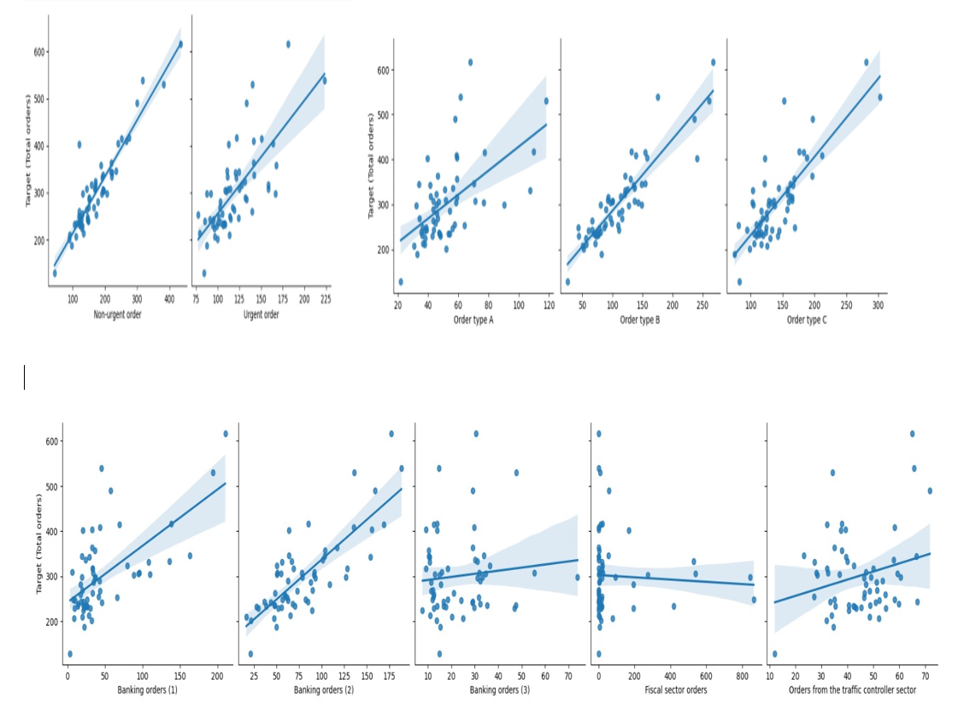
EDA ( Exploratory Data Analysis):

Slide 13
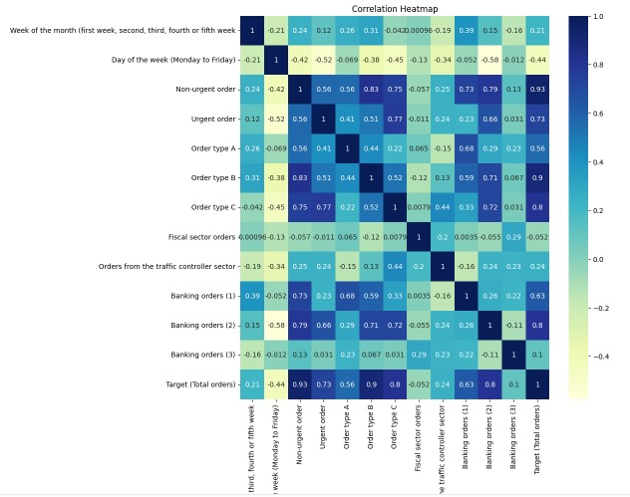
EDA ( Exploratory Data Analysis):
Positive correlation observed between 'non-urgent order', 'Urgent order' and 'Total Orders', though strong positive for 'non-urgent order' and Moderate positive for 'Urgent order’.
Order type (A), (B) and (C) showing positive correlation, strong positive in (B), moderate in (C) and weak for the (A).
There is almost no correlation in banking orders (3) ,while negative correlation is observed in ‘Fiscal sector Orders’.

Slide 14
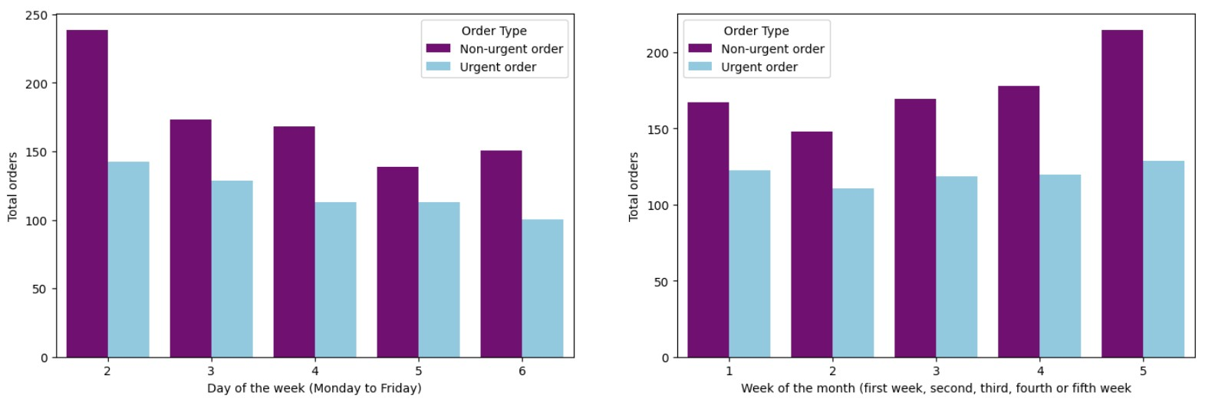
EDA ( Exploratory Data Analysis):
Bar Graph
Bar graphs are effective for comparing the magnitudes of categorical data making it easy to understand the trends.
Bar graph is plotted to show trends for week-wise and Day-wise.

Slide 15
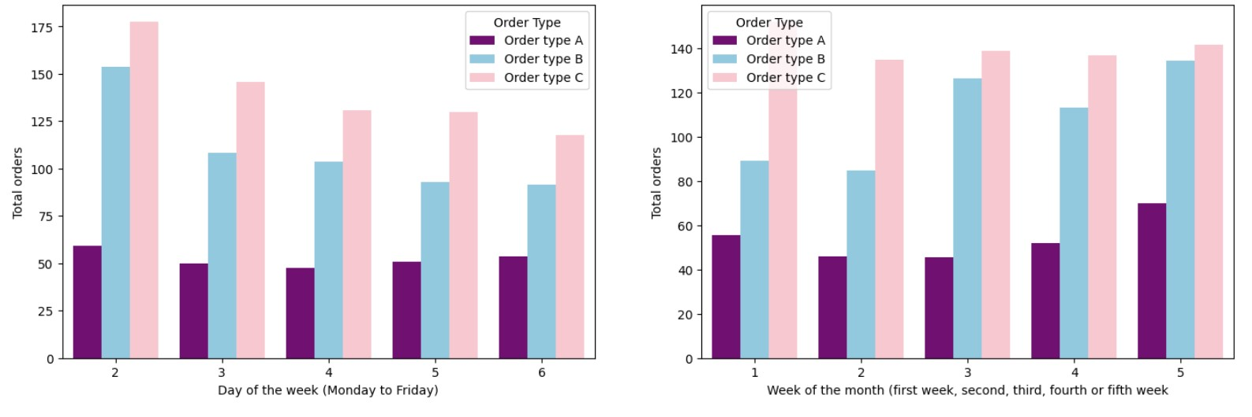
EDA ( Exploratory Data Analysis):

Slide 16
EDA ( Exploratory Data Analysis):
Generally, 'non-urgent orders' and 'Urgent orders' showing peaks significantly on the “Monday: Day of the week” while “fifth week: Week of the Month.”
'Urgent orders' showing relatively consistent patterns across the week (2 to 6) and the Week of the Month.
Order type A showing almost consistent patterns of ‘Total Orders’ across the “Day of the week” and “Week of the Month”.
'Order Type B' and 'Order Type C' show higher 'Total Orders' during weekdays.
'Order Type B' exhibits relatively consistent patterns across different days of the week.

Slide 17
EDA ( Exploratory Data Analysis):
4
Distribution of data
It is a statistical concept that describes the distribution of the data .
Orders from Traffic controller sector having normal distribution of data while fiscal sector orders are completely flat at X axis.
Banking orders 2 followed by 1 and 3 normal distributions of the data.

Slide 18
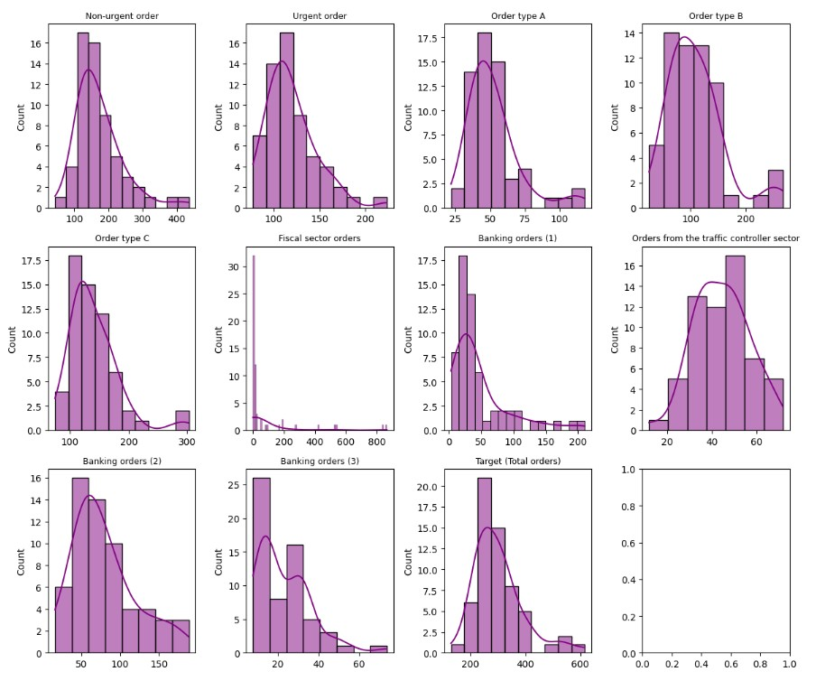
EDA ( Exploratory Data Analysis):

Slide 19
Feature Selection:
In this phase we have selected the features based on what we observed during the EDA like since Fiscal sector orders has so much small correlation and highly affected with outliers so we decided to drop it from the features column.
Here we have checked the Variance inflation factor for selecting the features too .
Since it’s a time series data so we are taking the feature sets as week of the Years , Day , month , Day of the week too.

Slide 20

Model Use
1
Machine Learning Model:
Adaboost
XGBoost
Lasso Regression
Catboost
LSTM Approach
2
Time Series Model:
Arima
HWES (Holt-Winters Exponential Smoothing)
SARIMAX
SARIMAX with Regressors
Prophet
Prophet with Regressors

Slide 21

Model Use
Regression Analysis:
Regression Analysis measure the nature and event of the relationship between 2 or more variable, thus enable us to make prediction.
Regression is the measure of the average relationship between 2 or more variable.
Adaboost:
Adaboost is an ensemble learning technique that builds a strong model by sequentially training multiple weak learners.
Adaboost assigns varying weights to each data point based on its correctness during training.
The final model in Adaboost is a weighted sum of the individual weak learners.
Hyperparameter tunning of the model include number of weak learners and the learning rate for each learner.
The tuning process aims to find a balance between model complexity and avoiding overfitting.

Slide 22
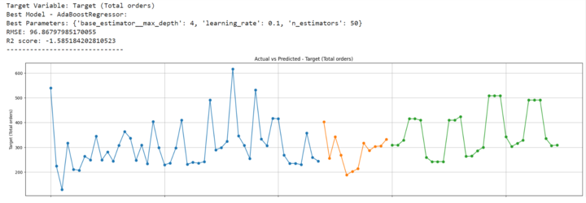
Model Use
Adaboost:

Slide 23

Model Use
XGBoost:
XGBoost is an ensemble learning algorithm that combines the predictions of multiple decision trees through boosting.
It minimizes a regularized objective function.
The algorithm adds decision trees sequentially to correct errors made by previous trees.
Hyperparameter Tuning:
n_estimators.
Learning_rate (step size).
Max_depth.
Subsample.
XGBoost was selected for its effectiveness in handling time series forecasting tasks.

Slide 24
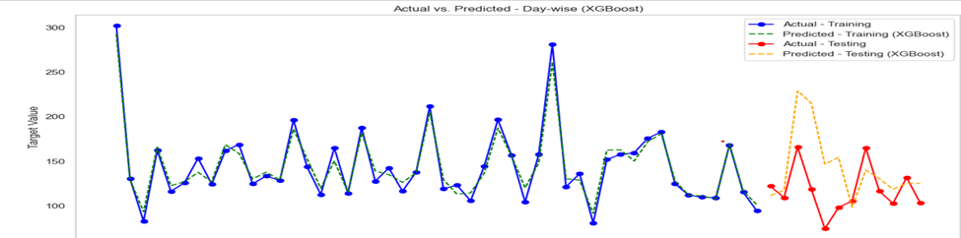
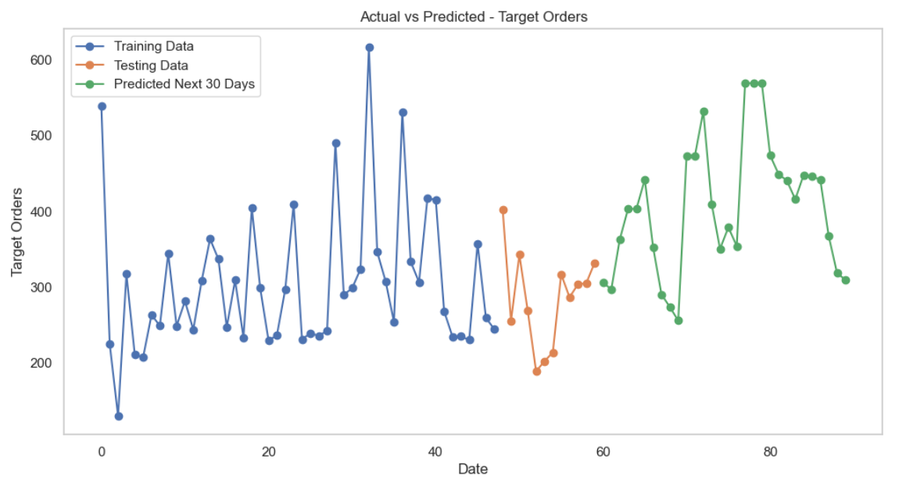
Model Use
XGBoost:

Slide 25
Model Use
Lasso Regression:
Lasso Regression is a linear regression technique that incorporates L1 regularization( i.e. add penalty terms).
Lasso Regression has ability to perform automatic feature selection.
The regularization term helps prevent overfitting and promotes a more interpretable model.
Lasso Regression introduces a shrinkage effect on the coefficients, pulling them towards zero.
Hyperparameter Tuning: alpha (often denoted as λ, lambda) controls the strength of the regularization.

Slide 26
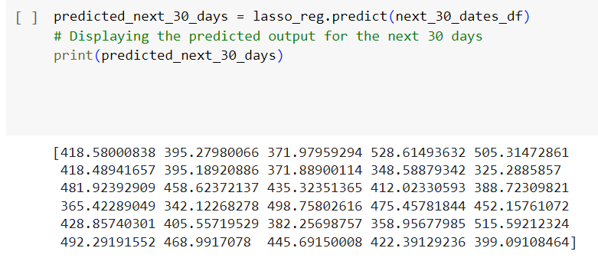
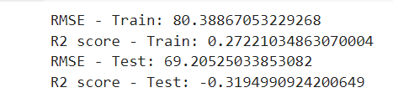
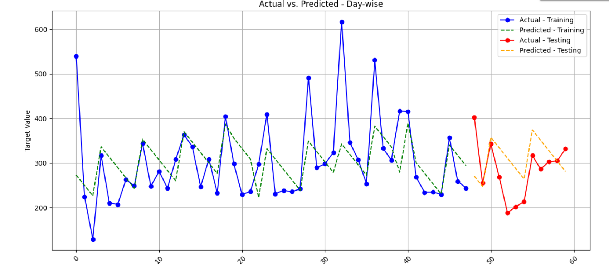
Model Use
Lasso Regression:

Slide 27
Model Use
CATBOOST:
CatBoost Regressor is a gradient boosting framework designed for regression tasks.
It predicts continuous target values.
Handles diverse data.
The regularization term helps prevent overfitting and promotes a more interpretable model.
It combines decision trees in a sequential manner.
Hyperparameter Tuning:
Learning rate.
Depth
Number of trees

Slide 28
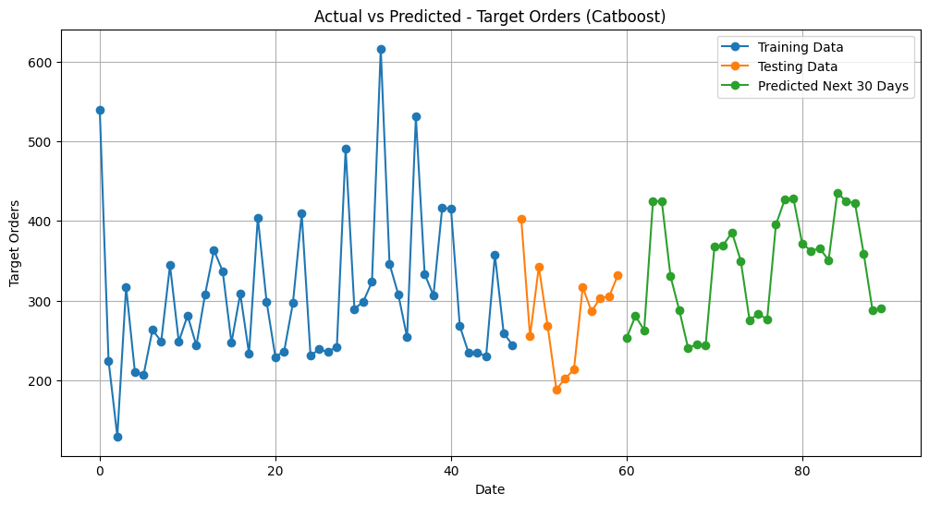
Model Use
Catboost:

Slide 29
Model Use
LSTM:
LSTM (Long Short-Term Memory) network is a type of RNN recurrent neural network.
It is capable of handling and processing sequential data.
Hyperparameter Tuning:
Learning rate.
Number of LSTM Units (Neurons)
Number of LSTM Layers
Dropout Rate

Slide 30
Model Use
ARIMA:
ARIMA stands for AutoRegressive Integrated Moving Average.
ARIMA models work with stationary data, where the mean and standard deviation remain relatively constant over time.
These are time series models that predict values based on their past values.
Hyperparameter Tuning:
p: Autoregressive Order. This is the number of past observations considered for making future predictions.
q: Moving Average Order. It accounts for a specific number of previous residuals when making future predictions.
d: Integration Order. It determines the number of differences needed to make the time series stationary (T(q) — T(q-1)).

Slide 31
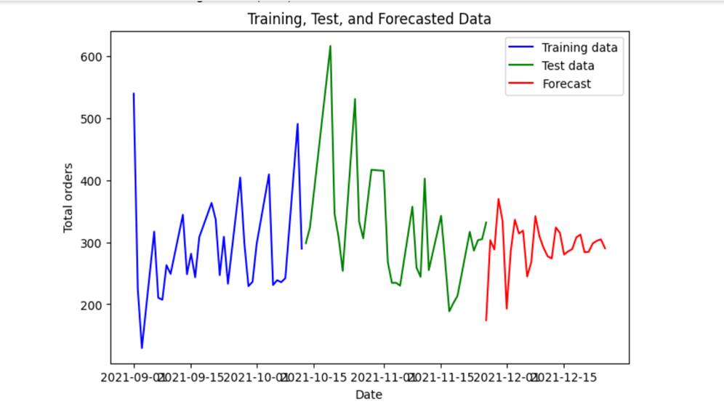
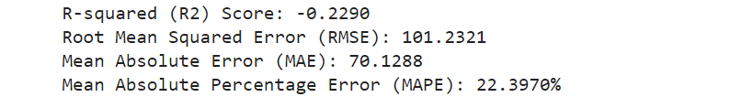
Model Use
ARIMA:

Slide 32
Model Use
SARIMAX:
SARIMAX stand for Seasonal Autoregressive Integrated Moving-Average with Exogenous Regressors.
It is a generalization of the ARIMA model that considers both seasonality and exogenous variables.
SARIMAX models are among the most widely used statistical models for forecasting, with excellent forecasting performance.
Hyperparameter Tuning:
p is the order (number of time lags) of the autoregressive part of the model.
d is the degree of differencing (the number of times the data have had past values subtracted).
q is the order of the moving-average part of the model.
P is the order (number of time lags) of the seasonal part of the model
D is the degree of differencing (the number of times the data have had past values subtracted) of the seasonal part of the model.
Q is the order of the moving-average of the seasonal part of the model.
m refers to the number of periods in each season.

Slide 33
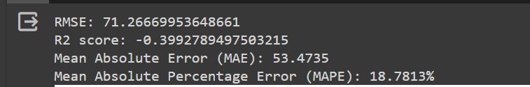
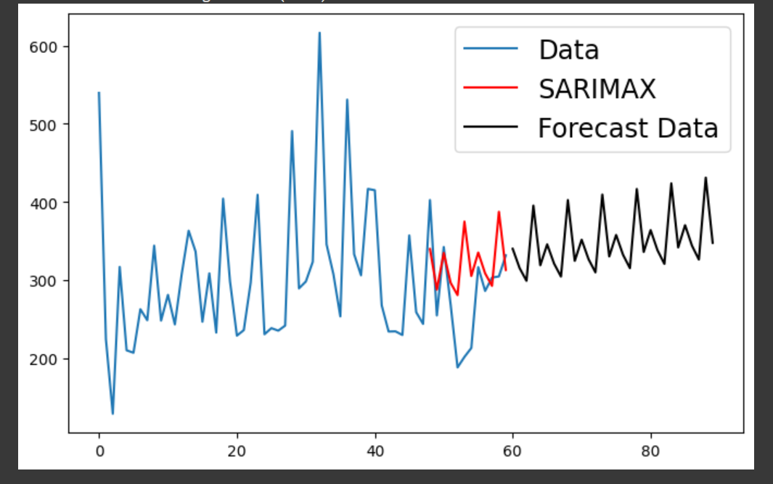
Model Use
SARIMAX:

Slide 34
Model Use
SARIMAX With Exogenous Variables:
SARIMAX stands for Seasonal AutoRegressive Integrated Moving Average with eXogenous factors..
It is a time series forecasting model that extends the capabilities of the traditional SARIMA model by incorporating exogenous variables, also known as external regressors.
Hyperparameter Tuning:
p is the order (number of time lags) of the autoregressive part of the model.
d is the degree of differencing (the number of times the data have had past values subtracted).
q is the order of the moving-average part of the model.
P is the order (number of time lags) of the seasonal part of the model
D is the degree of differencing (the number of times the data have had past values subtracted) of the seasonal part of the model.
Q is the order of the moving-average of the seasonal part of the model.
m refers to the number of periods in each season.

Slide 35
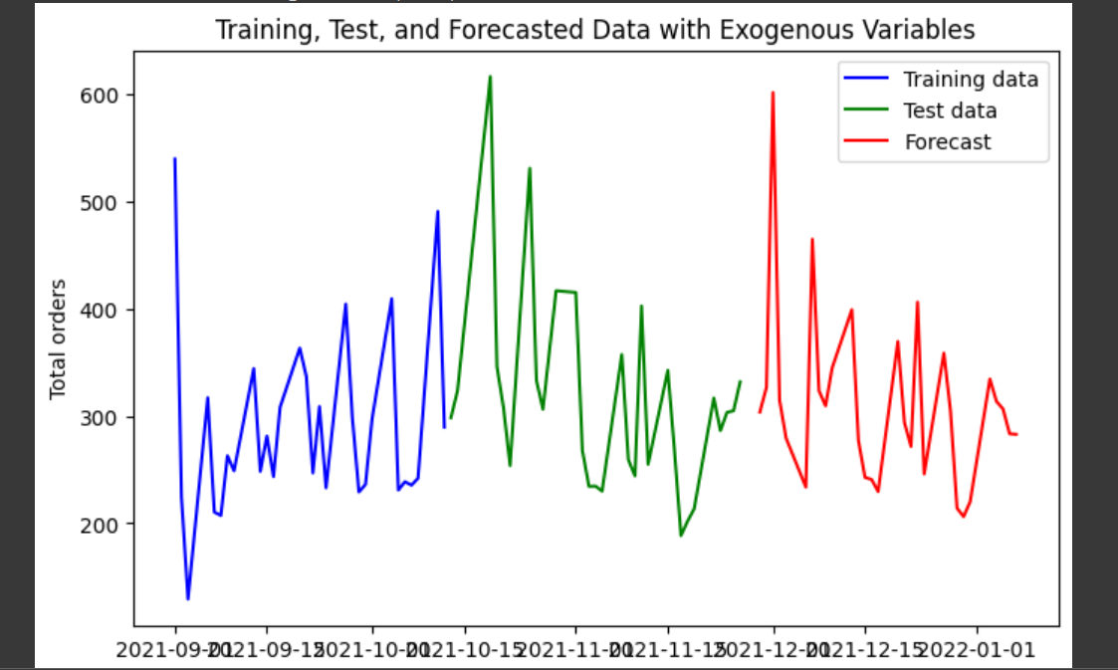
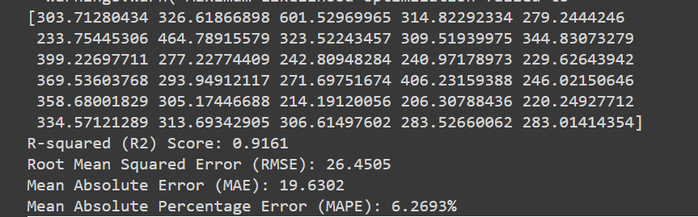
Model Use
SARIMAX With Exogenous Variables:

Slide 36
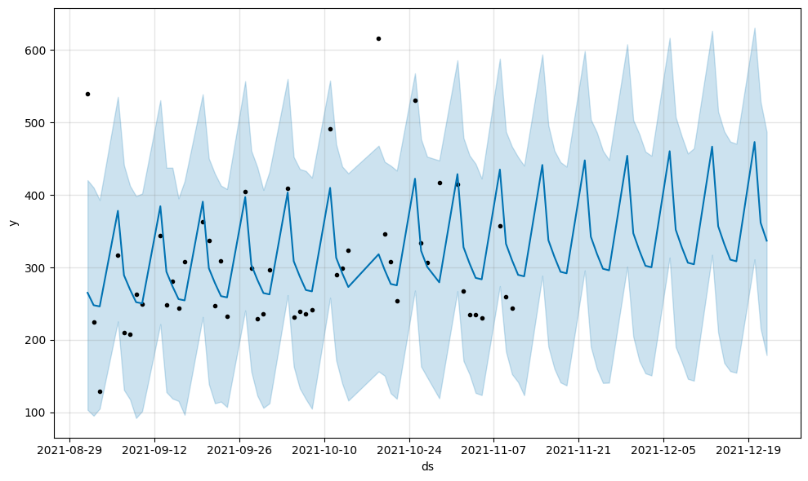
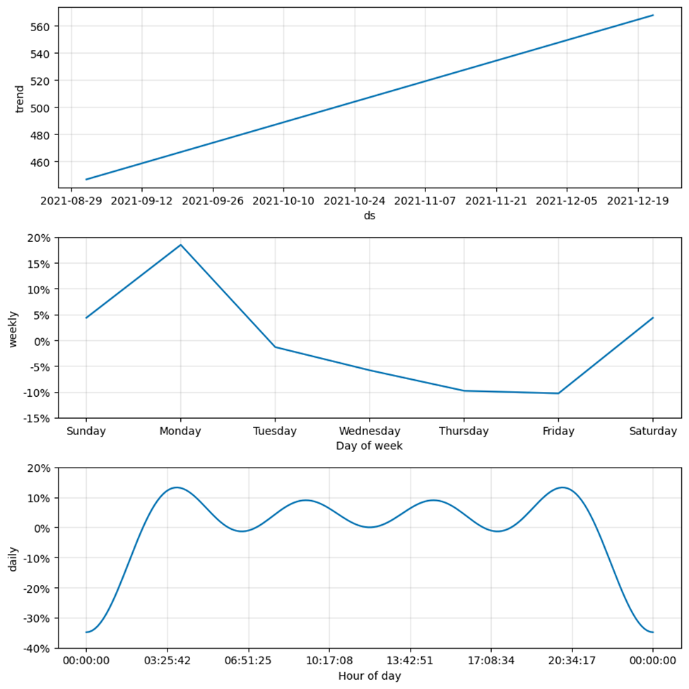
Model Use
Plotting the selected Components (Trend, Weekly & Daily) Using Prophet: -

Slide 37

Model Use
Metrics
Models |  | RMSE | R2-Score | Variance Score | MAPE
 | Machine Learning Approach
 | Linear regression | 9.568 | 1 | 1 | 2.751
 | Lasso Regression | 4.748 | 0.993 | 0.994 | 24.924
 | Ridge Regression | 0.302 | 0.999 | 0.999 | 0.039
 | Decision Tree Regressor | 44.867 | 0.445 | 0.498 | 24.548
 | Gradient Boosting Regressor | 42.293 | 0.507 | 0.507 | 22.711
 | XGBoost Regressor | 43.956 | 0.467 | 0.499 | 22.675
 | Deep Learning Approach
 | MLP(Multi Layer Perception) | 2.322 | 0.998 | 0.998 | 25.187
 | MLP Regressor with 7 hidden layers, 25 neurons per layer, and 1000 iterations | 11.89 | 0.961 | 0.963 | 24.305
 | Time Series Forecasting Models
 |  | RMSE | R2-Score | Variance Score | MAPE
 | ARIMA | -0.229 | 101.232 | 70.128 | 22.397
 | HWES | -0.03 | 61.433 | 30.452 | 12.569
 | SARIMAX | -0.39 | 71.266 | 53.475 | 18.781
 | SARIMAX with Exogeneous Variable | 0.916 | 26.45 | 19.63 | 6.269
 | Prophet Model | -5.507 | 175.72 | 141.043 | 49.538
 | Prophet Model with Regressor | 0.8755 | 21.25 | 18.465 | 8.564
Metrics of model:

Slide 38
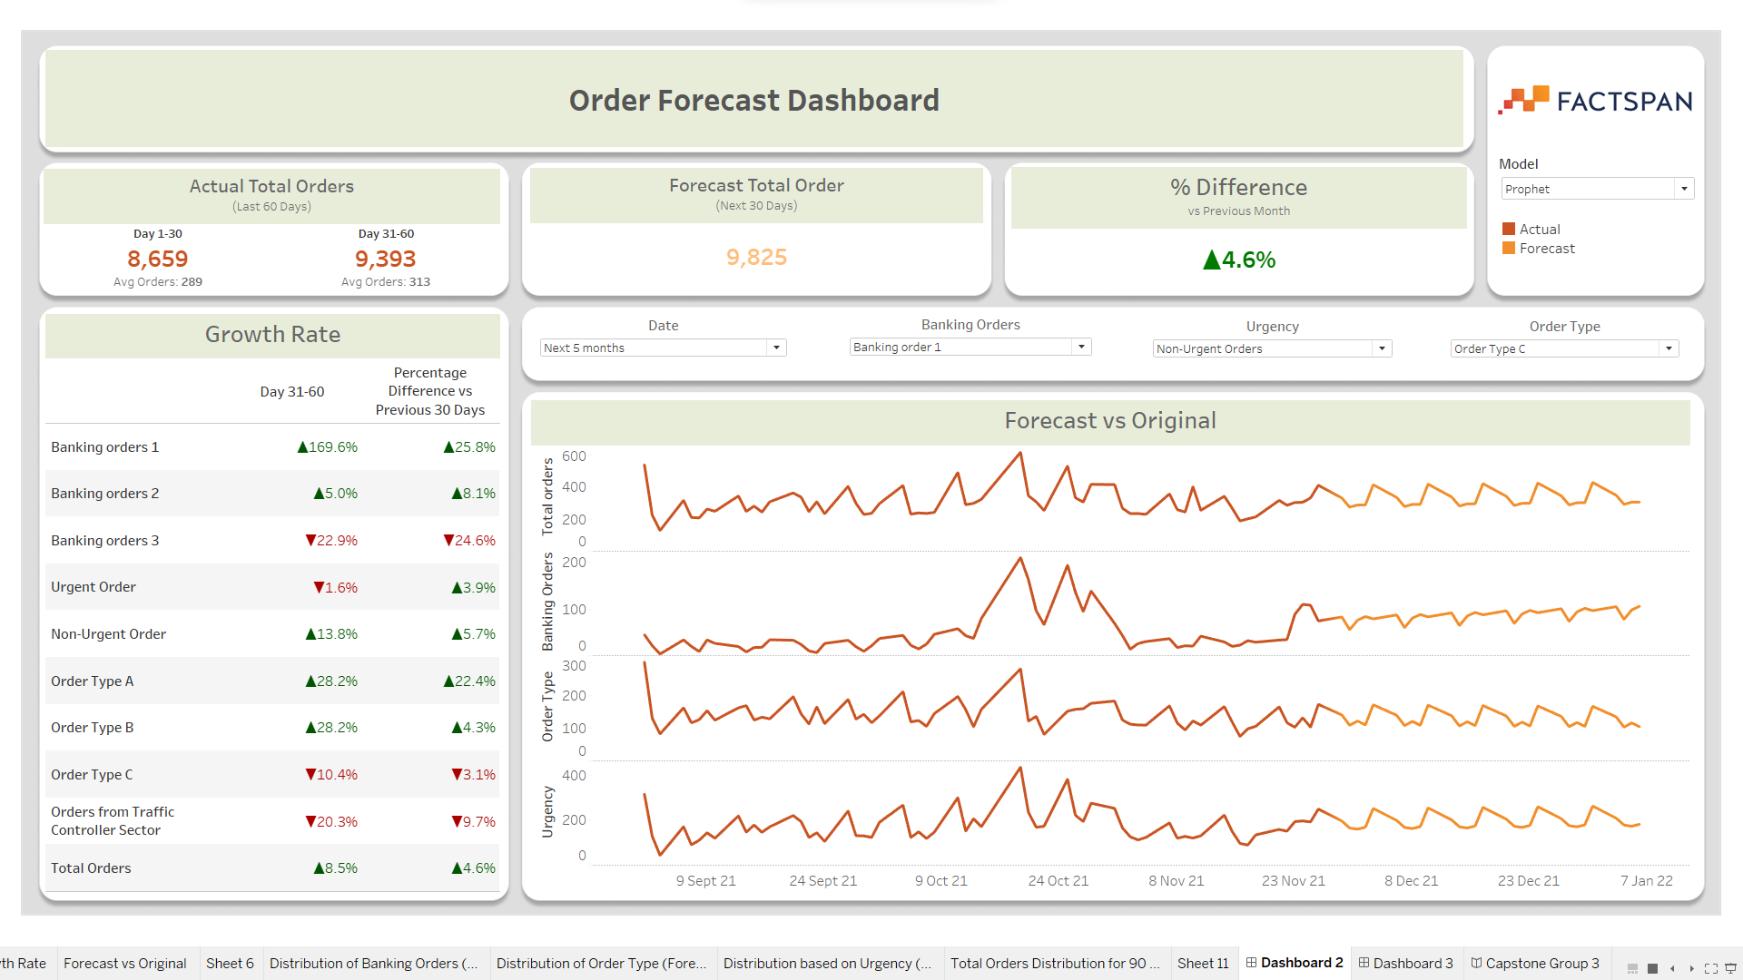
DashBoard Insight
https://public.tableau.com/app/profile/aaron.gunasingh/viz/CapstoneGroup31/CapstoneGroup3

Slide 39
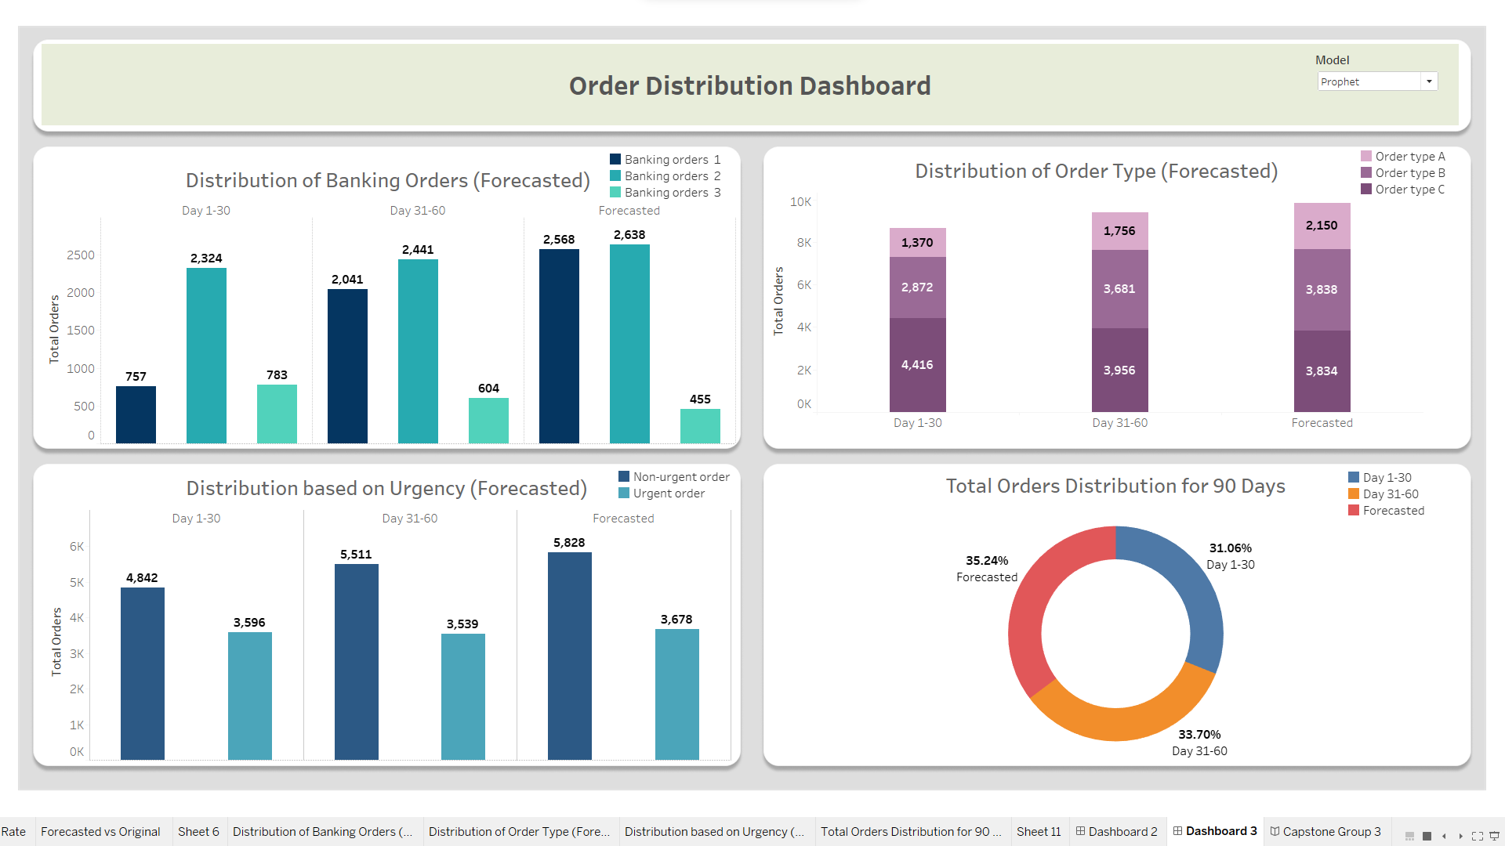
DashBoard Insight

Slide 40

Challenges & mitigation strategies
Challenges
Mitigation strategies
Raw Data Understanding
Data Visualization
Brainstorming
Discuss with Mentor
Feature Selection
Correlation Heatmap
Variance Inflation Factor
Time Series Data Diving
Date Synchronization
Date Addition with different components
Adding Month and Day from the Date
Model Selection
Using R2 , RMSE & Variance Score Diving into Time Series Data Added Different Seasonality Components

Slide 41



Lesson Learnt
Some insight on lesson learnt during the project are:
Correct Interpretation of Raw data is necessary as it may affect our model selection as well as result.
Data Quality is Paramount as quality of input data significantly influences model performance. Invest time in understanding and cleaning the data
Since its not a classical ML problems so we dig out more into time series data and then worked upon that.
Communication is Key,as effective communication between team members and mentor is essential for efficient work progress.

Slide 42
Annexure
Links :
Streamlit link: https://tidy-apples-reply.loca.lt/
GitHub link: https://github.com/Hasnain-Factspan/Capstone_Project.git
Tracker Link: https://docs.google.com/spreadsheets/d/1Qaxct4LZsaF1j3EkipwycW3n8RqlTmglhJknFEcOZ_s/edit#gid=0

Slide 43
Thank You!
www.factspan.com

